Slide 1
USER INTERFACES FOR
EMBEDDED SYSTEMS
Lecture 1: Introduction
Stefan Wagner
sw@eng.au.dk

Slide 2
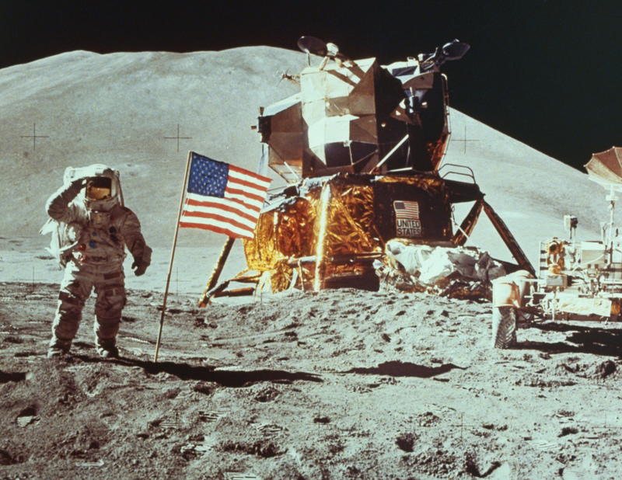
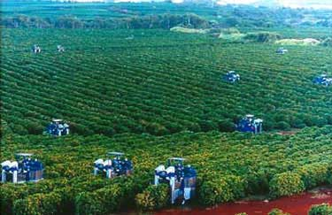
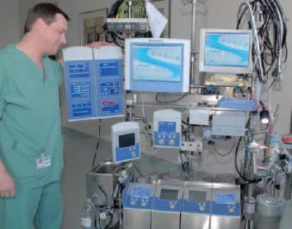
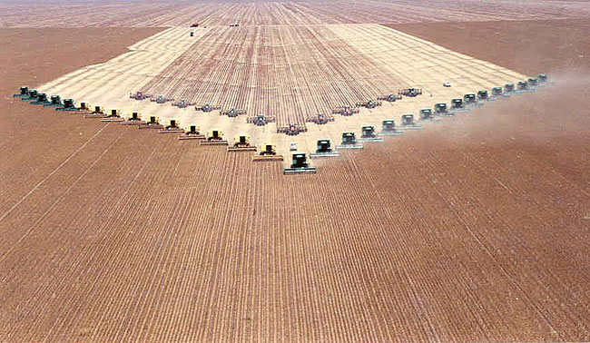
FREMSKRIDT !
PROGRESS !
Notes:
We are gettting ever more humans on the planet – and most us want more and more. More experiences, more travels, better healthcare, greater comfort, more and better food. To meet these demands – progress – has been the mantra ever since the stone ages – accellerating exponentially since the beginning of the industrial revolution.

Slide 3
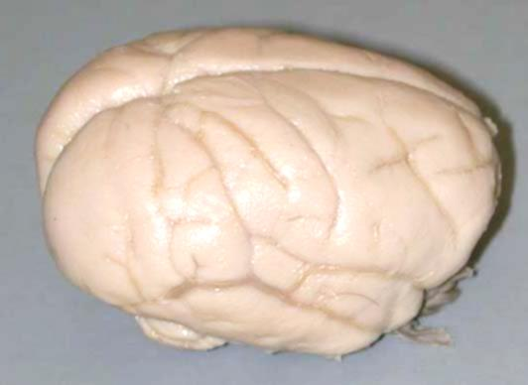
WHAT IS MANKIND’S SECRET FORMULA?
Our highly sophisticated brains
Supported by our hands, legs, and our senses
Which has allowed us to develop tools and technology
Notes:
What is mankind’s secret formula – who has enabled us to spread all over the planet – and even go beyond our planet? The brain.
One of the most sophisticated mechanisms ever engineered (developed or evolved)

Slide 4
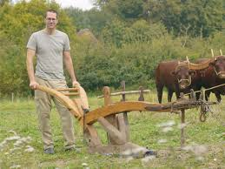

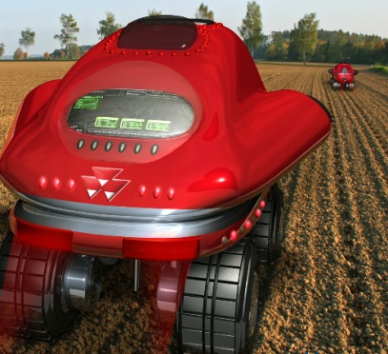
TECHNOLOGY AS THE DRIVER
Vorsprung durch Technik
Machines, computers and devices supports our continued progress – an artificial evolution of mankind
Computers and devices are getting increasingly more sophisticated and complex!
Notes:
Vorsprung durch Technik (German pronunciation: [ˈfoːɐ̯ʃpʁʊŋ dʊɐ̯ç ˈtɛçnɪk]; roughly "Advancement through technology"^{[1]}) is a German language phrase and the main advertising slogan and company ethos for the German car maker Audi. It has been used in Audi advertising campaigns all over the world.,^{[2]}

Slide 5
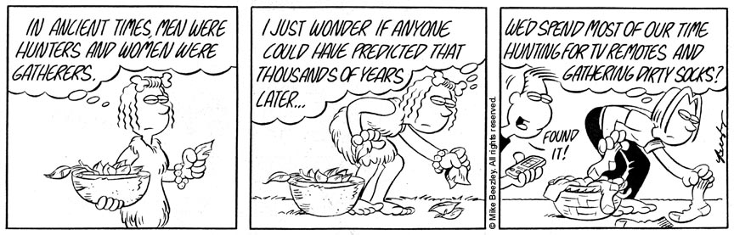
KEEPING UP WITH TECHNOLOGY
Our brains have not evolved much since the stone age
They are optimized by millions of years of evolution for hunting and gathering – not for operating machines

Slide 6
ASSIST THE BRAIN
Interaction devices interfaces humans and machines
Interaction devices and usability design helps to overcome the shortcomings of the brain in terms of understanding, learning, remembering, and interacting with machines
This course revolves around how the brain works and how to optimize the human computer interaction – or man machine interaction
To this end – a range of sciences and best practices exists

Slide 7
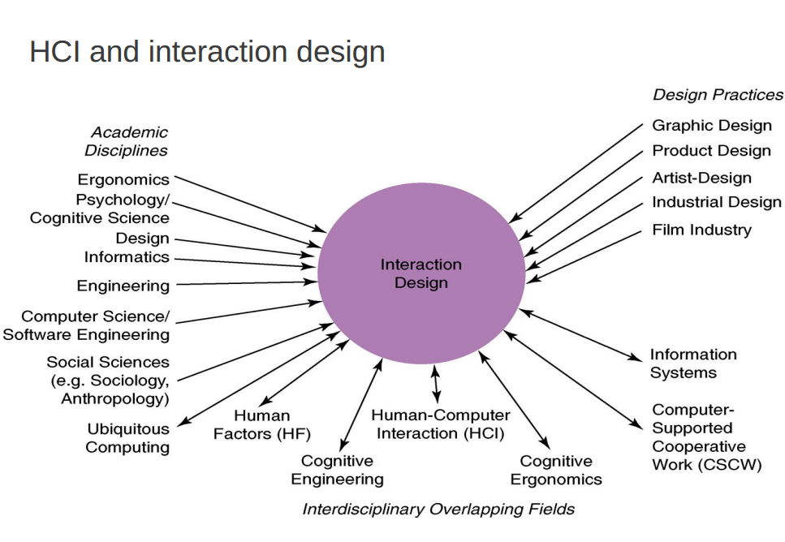

Slide 8
INTERACTION DESIGN
Common elements to iterate upon
  Establishing requirements
  Designing alternatives
  Prototyping
  Evaluating
Core characteristics
  Users should be involved through project development
  Usability and UE goals need to be identified, clearly documented and agreed at the beginning of the project
  Iteration is needed through the core activities

Slide 9
USER EXPERIENCE AND USABILITY
Many definitions exist
Definitions have evolved over time
Loosely, usability is
  Ability of a user to use a product to carry out a task successfully
Loosely, user experience takes a broader view
  Users' entire interaction with a product
  Thoughts, feelings, and perceptions from that interaction
Often, usability and user experience is treated as one

Slide 10
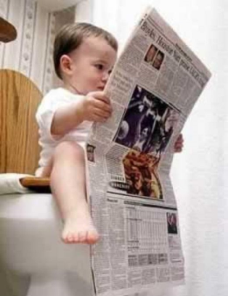
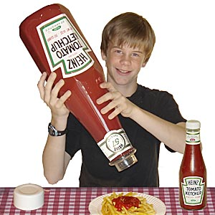
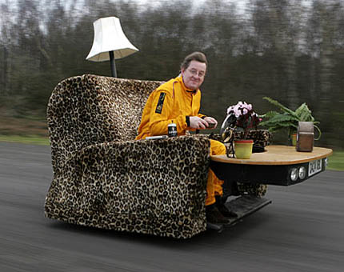
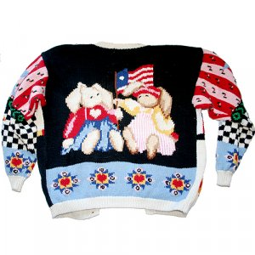
USER EXPERIENCE
All users of any product are left with an user experience
  Newspapers
  Ketchup bottles
  Armchairs
  Sweaters
We will focus on digital products

Slide 11
USABILITY DEFINITION 1: ISO
International Standards Organization (ISO) 9241-11:
  “The extent to which a product can be used by specified users to achieve specified goals with effectiveness, efficiency and satisfaction in a specified context of use”
(Effectiveness: Power to be effective)
Effective: Capable of producing an intended result
Efficiency: The extent to which time is well used for the intended task
Satisfaction:Fulfillment of a need or desire

Slide 12
USABILITY DEFINITION 2: UPA
Usability Professionals Association (UPA):
  “Usability is an approach to product development that incorporates direct user feedback throughout the development cycle in order to reduce costs and create products and tools that meet user needs.”

Slide 13
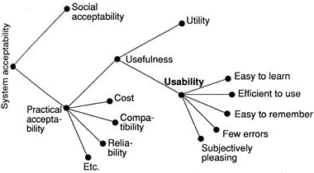
USABILITY DEFINITION 3: JAKOB NIELSEN

Slide 14
USABILITY GOALS
Effectiveness (effective to use): Is the product doing what it is supposed to?
Efficiency (efficient to use): Does product support users in carrying out tasks?
Safety (safe to use) : Does product keep users safe and free of undesired situations?
Utility (being of practical use) : Does product provide the right functionalities?
Learnable (easy to learn): How easy is the system to learn to use?
Memorable (easy to remember how to use): How easy is it to remember how to use the system?

Slide 15
USER EXPERIENCE GOALS
Desirable aspects
Satisfying, Helpful
Enjoyable, Motivating
provocative, Engaging
Challenging, Surprising
Pleasurable, Enhancing
Sociability, Rewarding
Exciting, Supporting creativity
Emotionally, Fulfilling
Entertaining, Fun
Cognitively stimulating
Undesirable aspects
Boring, Unpleasant
Frustrating, Patronizing
Annoying, Cutesy
Childish, Gimmick
Making one feel guilty/stupid

Slide 16
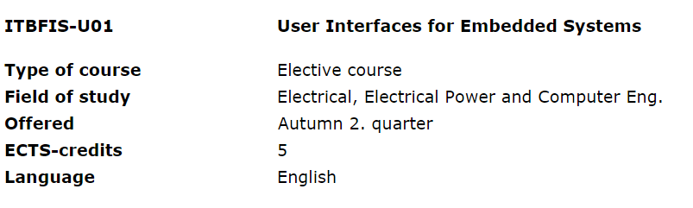
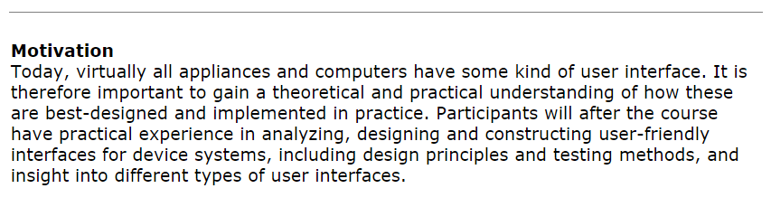
ABOUT THE COURSE

Slide 17
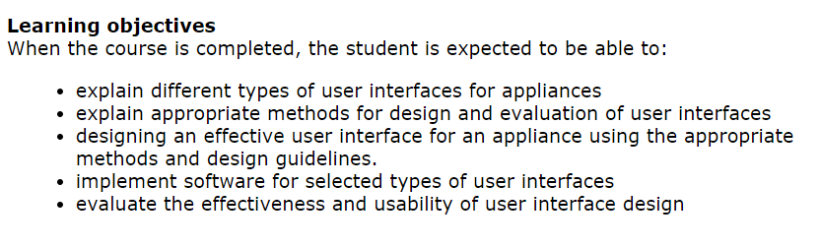
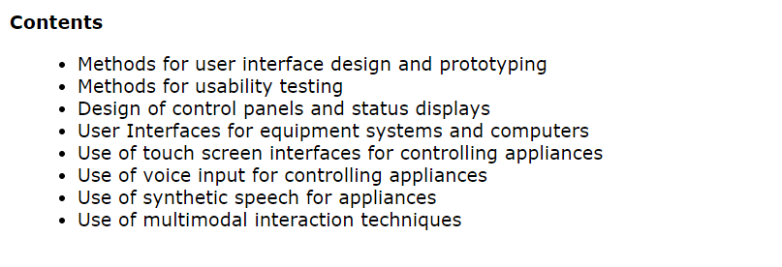

Slide 18
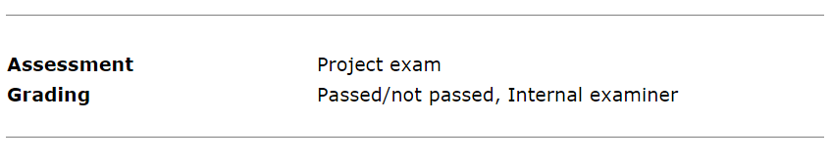
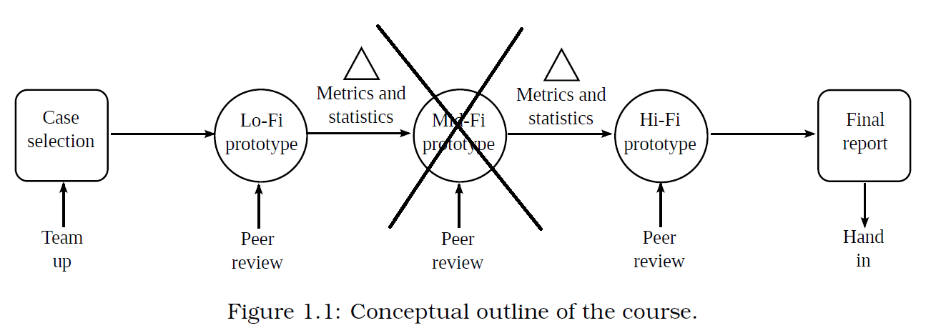
Seven questions will be handed out – roughly one for each week
2 x
2 x

